Slide 1
Course Brochure

Slide 2
What is in this ?
Feedback from Earlier Batches of FMS
About Chandoo.org
About Pristine & Financial Modeling
Topics Covered
Methodology of Teaching
What to expect at end?
Who is going to Teach?
Cost & Duration of the Program
Contact Details

Slide 3
Earlier Batches of Financial Modeling School …,
So far, we have trained 400+ students in our Financial modeling school
By showing them how to build financial models, step-by-step
Using MS Excel

Slide 4
What people had to say
Overall it is excellent. The length is excellent. It fits within the attention span of most people and therefore the lesson is assimilated.
Thank you for the opportunity to view the lesson!
The course is an excellent idea and is a good way to make financial modeling training more accessible to people around the world.

Slide 5
What people had to say
This is Best Financial Modeling for small scale to Large Scale Industries irrespective of Product, services, Builders, Dealers, Franchises.
Having the lessons available to download so can look at again easily is great!
They have not restricted themselves to just constructing the Financial Model(FM) rather very receptive and flexible in their approach and willing to get feedback and share ideas

Slide 6
About Chandoo.org

Slide 7
Chandoo.org makes you awesome in Excel
Chandoo.org is a leader in MS Excel training & products
We have trained more than 4,000 students in Excel, VBA & Financial Modeling
We have authored more than 450 articles on MS Excel & how to use it
We have a large & vibrant community of Excel users world-wide
And We Make You Awesome In Excel

Slide 8
About Pristine

Slide 9
Pristine is largest authorized trainer for finance certifications in India
CFA Institute (2010-11)
Authorized Training provider – CFA
Pristine is now the authorized training provider for CFA Exam trainings . Pristine is largest training provider for CFA in India with presence across seven major cities.
GARP (2007-10)
Authorized Training provider -FRM
Largest player in India in the area of risk management training. Trained 1000+ students in risk management
PRMIA (2009-10)
Authorized Training provider – PRM/ APRM
Sole authorized training for PRM Training in India. Largest player in India in the area of risk management training. Trained 1000+ students in risk management
FPSB India (2010-11)
Authorized Training provider -CFP
An authorized Education Provider for Chartered Financial Planner Charter.

Slide 10
Sample Trainings Conducted …,
Bank Of America
Continuum Solutions (2010)
Financial Modeling in Excel
Associates were trained on valuation and mergers and acquisitions
J. P. Morgan (2010)
Financial Modeling in Excel
The Real Assets Group were trained in Excel for infrastructure and real-estate modeling
Mizuho (2010)
Financial Modeling in Excel
Bankers were using excel models that they could not understand. Conducted financial modeling in Excel trainings to bridge the gap
IIM Calcutta (2010)
Financial Modeling in Excel
Students about to go for internships and join jobs found a gap in their grasp of knowledge of excel for financial modeling. Conducted training for 75+ students with an average rating of 4.5+
FMS Delhi (2010)
Financial Modeling in Excel
Final Year MBA students of Faculty of Management Studies, Delhi University were trained in financial modeling so as to prepare them better for a job in finance.
HSBC (2009)
Analysts of the global
investment baking team were
trained on advanced Excel
*Indicative List

Slide 11
About Financial Modeling
Financial modeling training is
an online training program*
that can enable you
to create a complete integrated financial model in excel

Slide 12
About Financial Modeling
Delivered online
Each student gets a secure log-in
No-need to be online at a specific time
Lessons can be taken repeatedly
Financial modeling training is
an online training program*
that can enable you
to create a complete integrated financial model in excel
=

Slide 13
About Financial Modeling
Building the model from scratch
Step by step tutorials and templates
Practical understanding of financial statements
Financial modeling training is
an online training program*
that can enable you
to create a complete integrated financial model in excel
=

Slide 14
About Financial Modeling
Where you comprehensively analyze financial statements
Changing any assumption or part of the model reflects in all other parts
Best suited for people working/ planning career in
Investment Banks
Equity Research
Business planning/ Strategy
PE, Funds
Commercial banks
Financial modeling training is
an online training program*
that can enable you
to create a complete integrated financial model in excel
=

Slide 15
Topics Covered

Slide 16
Integrated valuation would be completed by …
Designing an efficient layout
Inputting the historical statements
Analyzing the growth drivers
Forming growth assumptions
Projecting future P&L and B/S
Creating Asset & Dep. Schedule
Creating Debt schedule
Equity & Retained Earnings
Creating Cash Flow statement
Circular loop and Cash updation
Analyzing Ratios
Valuation by DCF
Valuation by Comps
Charting a football field
You would be able to create a complete Integrated Valuation model (For emerging Markets) in FMCG/ Manufacturing sector in 20 Hrs duration

Slide 17
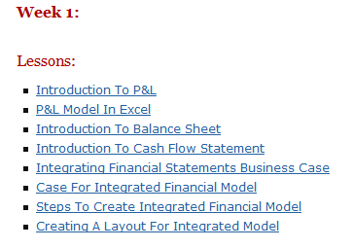
Study Session: Week I
Pre-requisites to Financial Modeling
Understanding Financial Statements (FSS)
Profit & Loss (P&L) Statement
Balance Sheet (B/S)
Cash Flow Statement
Financial Statement Analysis
Line items and linkages in the FSS
You would learn all the Basic Financial Statements and its analysis techniques

Slide 18
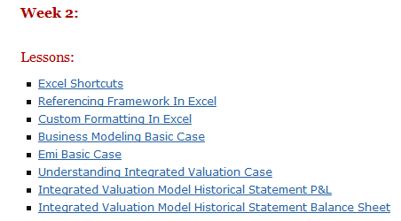
Study Session: Week II
Essential Excel Usage (Referencing framework & shortcuts)
Short Modeling Case
Funding eligibility for startup company
Equated Monthly Installments (EMI)
Analyzing financial case study & back of the envelop calculations
Integrated Model (Step I) - historical financial statements
You would learn essentials of Excel for Financial Modeling

Slide 19
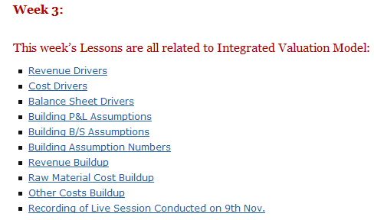
Study Session: Week III
Calculating Growth drivers
P&L (YoY and CAGR)
B/S (Days (of inventory, A/R, etc.))
Understand Management Discussion Analysis (MDA)
Build Assumptions about the future
Project revenues/ costs
You would learn steps in analyzing growth drivers and projecting future numbers

Slide 20
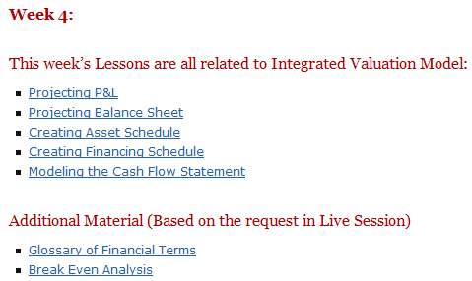
Study Session: Week IV
Part projecting P&L and B/S
Projecting Asset and Depreciation
Projecting Debt and Interest
Projecting PAT and Retained Earnings
Modeling Cash Flow
Case on Break Even Analysis
You would learn steps in creating schedules that cut across P&L and B/S

Slide 21
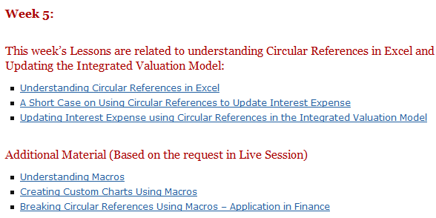
Study Session: Week V
Advanced aspects of excel
Circular references
Macros
Understanding Circular reference
Circular references in interest expense
Macros to generate charts
Macros to break circular loops
Learn application of advanced excel functions – Macros and Circular references in Finance

Slide 22
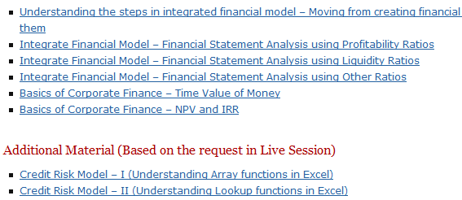
Study Session: Week VI
Analyzing the statements
Using ratios
Profitability
Liquidity
Others
Basics of corporate finance
credit risk Model - Arrays and lookup functions
Learn Financial Statement Analysis in Excel and Array functions for Credit Risk Modeling

Slide 23
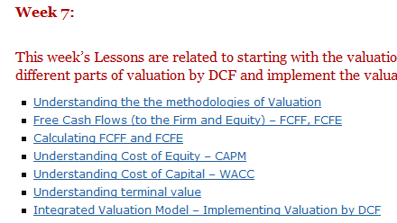
Study Session: Week VII
Understanding Valuation methodology
Absolute valuation - DCF
Comps (comparatives)
Implementing DCF
Cash
Timing of cash
Expectation of investors (Cost of capital)
Learn and Understand and Implementation of Valuation Techniques

Slide 24
Study Session: Week VIII
Practice and Implement a Completely Integrated Valuation Model
Practice on Actual Industry Model

Slide 25
Study Session: Week IX
Valuation by Comps (Comparatives)
Transaction comps & Trading comps
Important multiples like P/E, EV/ EBITDA, EV/ Sales
Modeling advanced Accounting Concept - Deferred Taxes
Creating forms in Excel
Learn and Understand and Implementation of Valuation Techniques

Slide 26
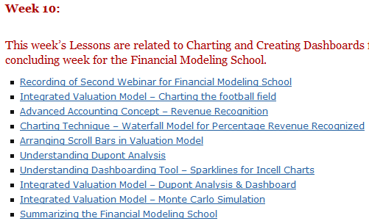
Study Session: Week X
Charting Theme
Football field
Waterfall Mechanism
Creating Valuation Dashboard
Monte Carlo Simulation
Learn Charting Techniques relevant to finance in Excel

Slide 27
Introducing Project Finance Financial Modeling

Slide 28
Project Finance Financial Modeling
Nuances of PF Model
PF Model for RE
FSS Nuances for Project finance
Components of RE Financial Model
RE Investments: Key Metrics
Key Concepts in RE Model
Understanding circular loops in Excel
Interest During Construction
Modeling Depreciation and Deferred Taxes
Deferred Tax and Loss Carried Forward
Cash Distribution and Tranches
Modeling Delays
Debt Servicing Reserve Account (DSRA)
Modeling Commercial Complex
Modeling Assumptions
Modeling Area parameters
Modeling EPC Cost and Phasing
Modeling financing Schedules
Modeling NOI and Expenditure
Building financial statements
Valuation and Analysis
You would be able to create a complete Integrated Valuation model (For emerging Markets) in Real Estate sector in 20 Hrs duration

Slide 29
How it works?
1
2
3
4
5
You signup for the program by making online payment
$297

Slide 30
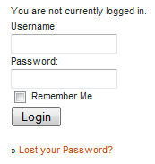
How it works?
1
2
3
4
5
Login to Financial Modeling School with the user ID & Password emailed to you

Slide 31
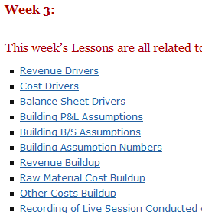
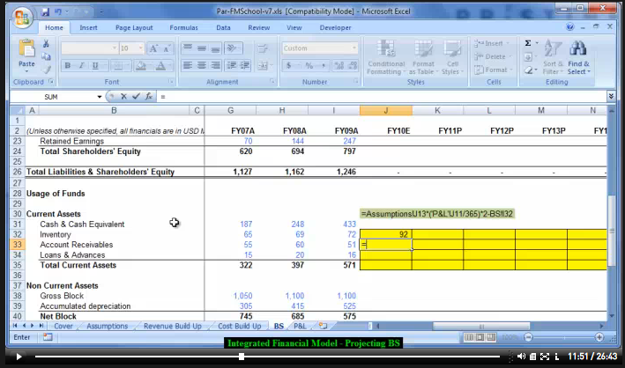
How it works?
1
2
3
4
5
Access Lessons, Videos and Download Examples As you Like

Slide 32
How it works?
1
2
3
4
5
Ask Questions or Comment on Lessons to Get Answers

Slide 33
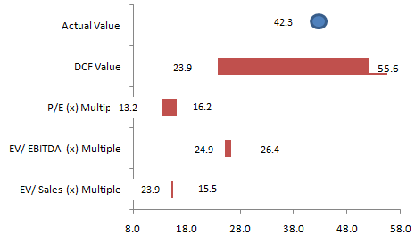
How it works?
1
2
3
4
5
Take up Home work & Class project assignments to Sharpen your Skills

Slide 34
Methodology
Each topic will be explained thru
Videos, Excel templates, Screencasts & Text Posts

Slide 35
About Class Projects
We have 2 short cases & 1 valuation project
We build 2 small models and 1 complete integrated valuation model as a project. The complete integrated valuation model can be created on any listed company.

Slide 36
What to expect at the end?
Towards the end of Financial Modeling Course*
You will be able to created an integrated model
You will know how to use financial statements for analysis
You will understand the process of valuation and capital raising
You will get a certificate of participation
*assuming you follow the program and practice

Slide 37
Who is going to teach?
Paramdeep Singh, Director and Faculty, Pristine
Paramdeep has an extensive experience in the financial services, consulting and training domain. He has extensive knowledge of the financial services industry, where he raised growth capital for organizations and helped them improve their revenues. He has authored research papers and trained 1000s of senior people in the area of financial modeling, quantitative analysis and risk management.
Prior to founding Pristine, Paramdeep has worked in senior management positions as an Investment Banker with Standard Chartered Capital Markets (India) and as a consultant with Accenture Management Consulting.
Paramdeep is an MBA from IIM Indore, where he secured the highest CGPA in his batch. He has completed his B. Tech and M. Tech in Mathematics and Computing from IIT Delhi

Slide 38
Duration of the Program – Financial Modeling
10 Weeks of Active Learning
6 Months Online Membership
Financial Modeling School classes start as soon as you join

Slide 39
Duration of the Program – Project Finance
10 Weeks of Active Learning
6 Months Online Membership
Project Finance Modeling School classes start as soon as you join

Slide 40
Cost of the Program
Learn Excel as well
Option | What you get? | Price in US $ | with Excel School ($)
Financial Modeling Class | Online Classes + Lesson Downloads on Financial Modeling using Excel | $297 | $397
Project Finance Class | Online Classes + Lesson Downloads on Project Finance using Excel | $297 | $397
Both Classes | Online Classes + Lesson Downloads on both financial modeling & project finance | $447 | $547
Modes of Payment |  | Credit Cards, PayPal, e-Checks
Click here to Join

Slide 41
Cost of the Program (for Indian Residents)
Learn Excel as well
Option | What you get? | Price in INR | with Excel School (INR)
Financial Modeling Class | Online Classes + Lesson Downloads on Financial Modeling using Excel | ₨ 12,000 | ₨ 16,000
Project Finance Class | Online Classes + Lesson Downloads on Project Finance using Excel | ₨ 12,000 | ₨ 16,000
Both Classes | Online Classes + Lesson Downloads on both financial modeling & project finance | ₨ 18,000 | ₨ 22,000
Modes of Payment |  | Bank Transfer, Check, DD or Cash Deposit
* This option is available for people currently living in India. To make a payment, please visit
http://chandoo.org/wp/financial-modeling/inr-pricing/

Slide 42
Payments & Registration
Registration is open 24x7
You can join the class at any time.

Slide 43
How to pay?
Visit http://chandoo.org/wp/financial-modeling/
and join us

Slide 44
Contact Details
Questions & Doubts?
Please e-mail me at paramdeep@edupristine.com
or visit http://chandoo.org/wp/
http://www.edupristine.com
or call +91 814 262 1090 or +91 989 298 0608

Slide 45
See you in Financial Modeling/ Project Finance School…

